Slide 1

Archery Game
Int 213 : project
Section: k19pv

Slide 2
About Archery Game
Archery is the art, sport, practice, or skill of using a bow to shoot arrows.
A person who participates in archery is typically called an archer or a bowman.
Archery game was discovered by the The Sasanian general Bahram Chobin has been credited with writing a manual of archery in Ibn al-Nadim's catalogue Kitab al-Fihrist. A complete arrow of 75 cm (along with other fragments and arrow heads) dated back to 1283 AD, was discovered inside a cave situated in the Qadisha Valley, Lebanon.
This game was GUI game based,

Slide 3
What is GUI Based game?
A GUI is a larger, broader term that's used to describe anything meant for the player (and not the character the player is controlling) to directly interact with. ... HUDs (Heads Up Displays) are GUI elements that display information in real time, while the user is playing the game
GUIs were introduced in reaction to the perceived steep learning curve of command-line interfaces (CLIs), which require commands to be typed on a computer keyboard.

Slide 4
WHAT IS SYS? WHAT ARE THE USES OF SYS?
Systems-based games are everywhere but most associated with the “immersive sim” genre. ... Players benefit from a more dynamic and varied game experience, and developers benefit through less rigid implementations of the core of their games.
The sys module provides information about constants, functions and methods of the Python interpreter. dir(system) gives a summary of the available constants, functions and methods. Another possibility is the help () function. Using help(sys) provides valuable detail information.

Slide 5
What is pygame?
Pygame is a cross-platform set of Python modules designed for writing video games. It includes computer graphics and sound libraries designed to be used with the Python programming language.
Pygame is a cross-platform set of Python modules which is used to create video games. It consists of computer graphics and sound libraries designed to be used with the Python programming language.

Slide 6
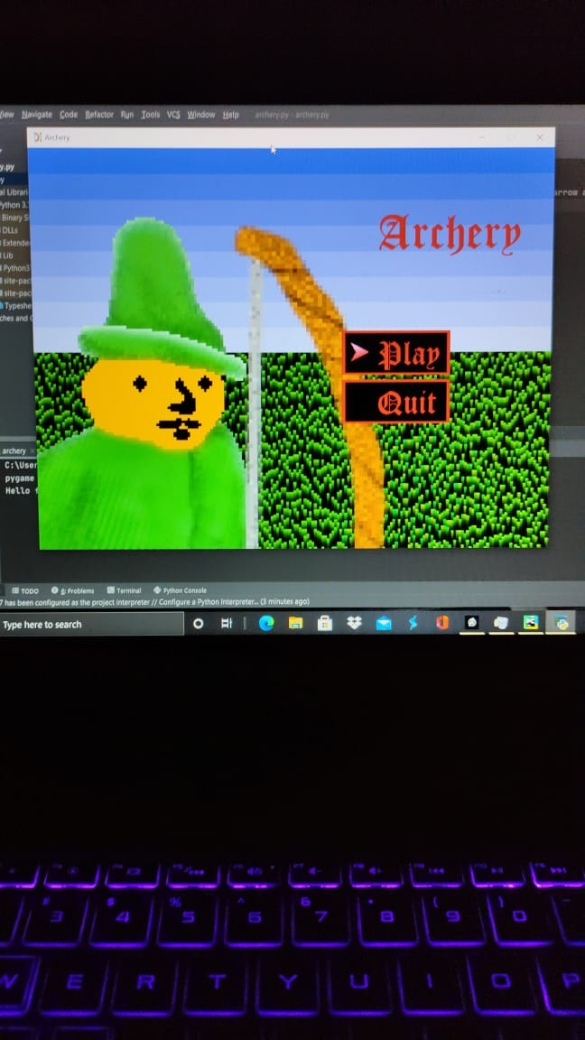
Description on Archery game
IN this archery game, this person want to good score by passing many difficulties level.
By selecting option play you can enter in the game.
By selecting option quit you can exit from the game.
Using the spacebar, you can hit the bow to the wheel of the different colour
Here each colour of the circle consist of the different score.

Slide 7


Slide 8
conslusion
In this project project we have a build a GUI based game which is based on libraries like pygame, sys, random. The logic behind the project is that, when the bow is floating on the left side and if you press space bar and release then the arrow shoots the target. If you shoot arrow at the middle of the target your score will be 3 and score of next two circles is 2,1 respectively.
In this project we have made several classes and based different functions. Also, we have made the use of inheritance.
So, what are you waiting for go and enjoy the game.

Slide 9

Submitted by:
Name roll no reg no
Manish kumar 26 11904532
Ganesh arekuti 65 11912261
Sindhuja priya 54 11902053

